Slide 1
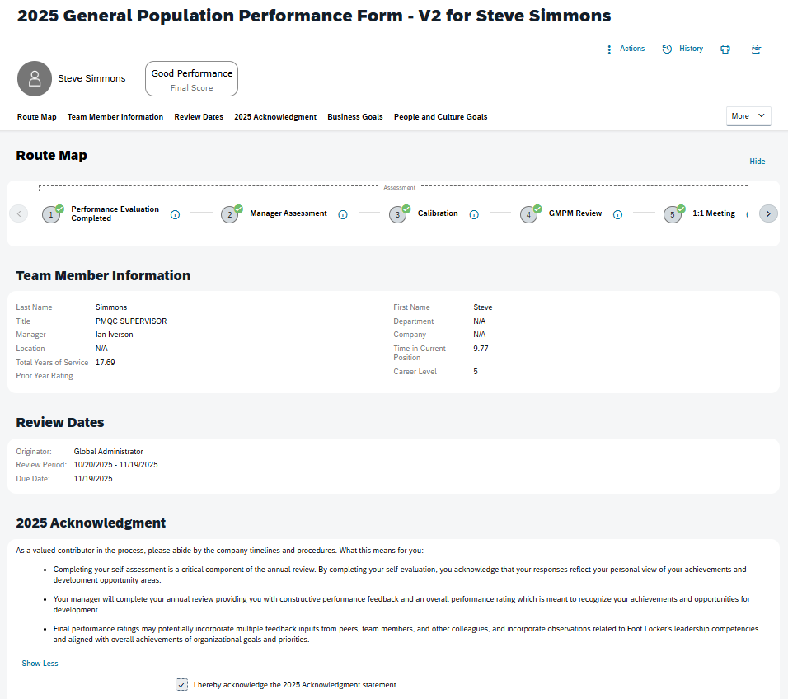
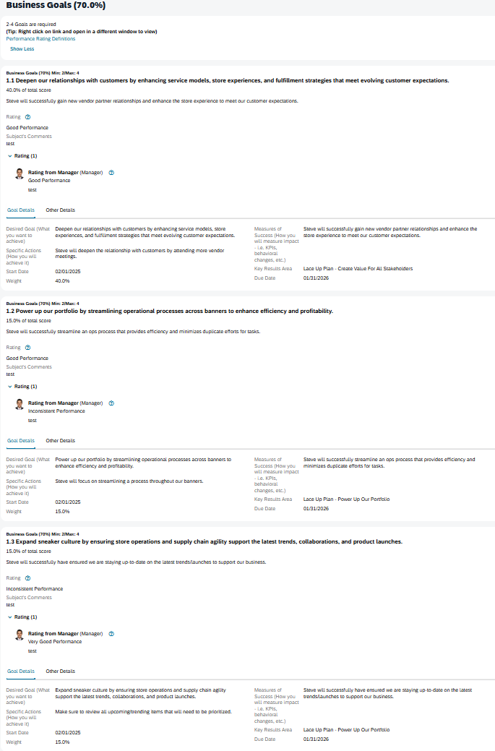
SuccessFactors: 2025 Performance Form Screenshots
Route map displays steps of the Performance process
Hovering over this icon to see who has access to each step in the performance process
Review dates section displays who launched the Performance Form, the Review period dates and Due date of the Form Completion
Team Member provides comments and self- ratings for each goal category - Business Goals , People and Culture Goals
Manager provides comments and ratings for each goal category - Business Goals , People and Culture Goals

Slide 2
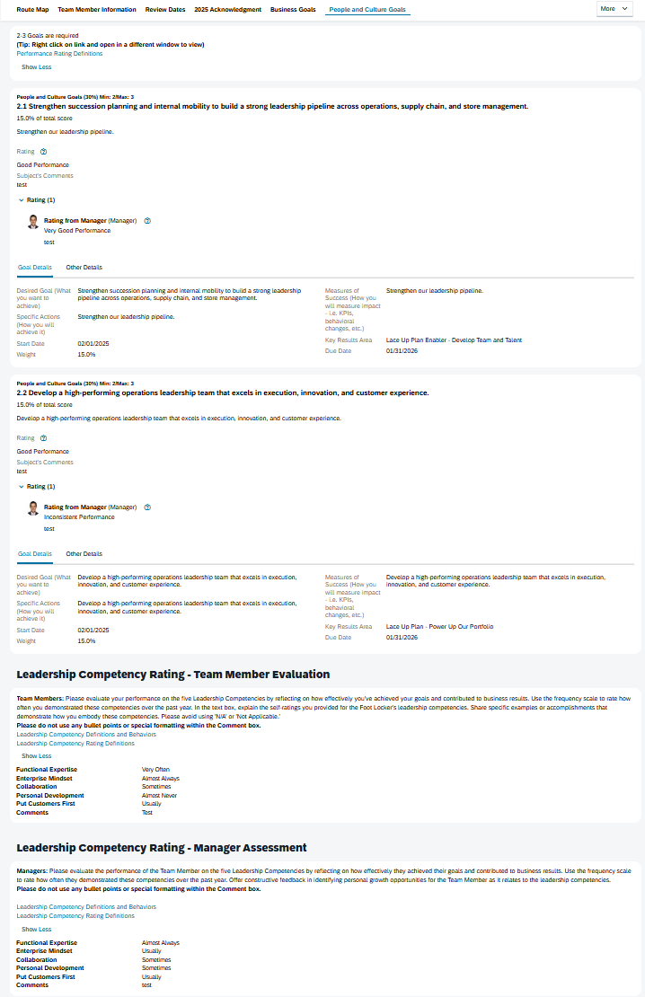
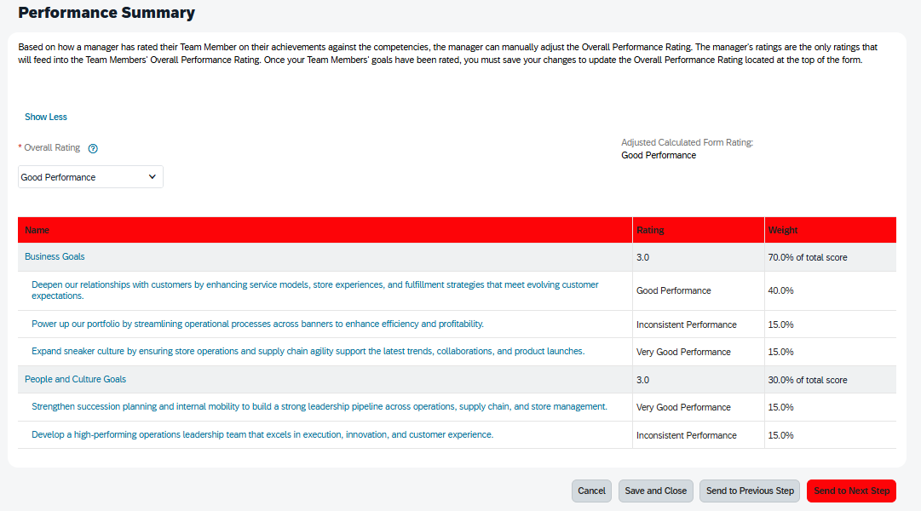
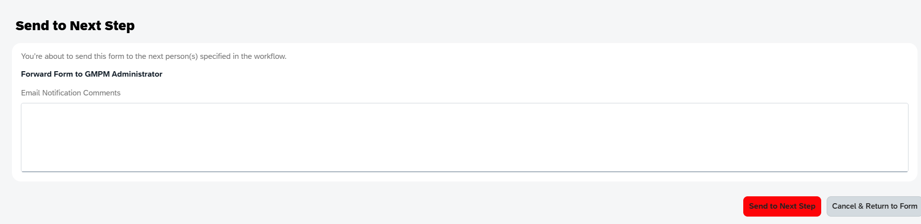
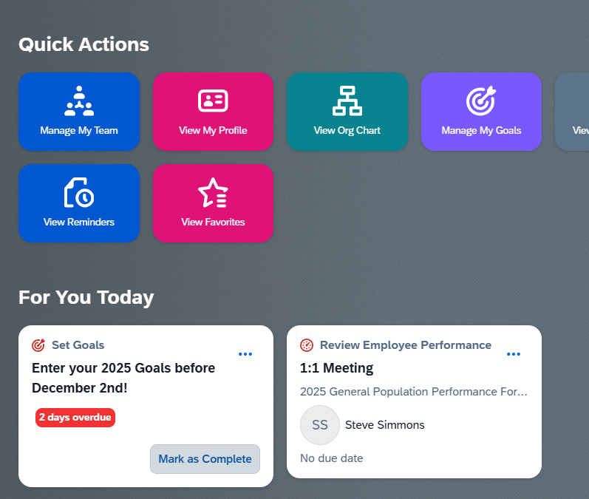
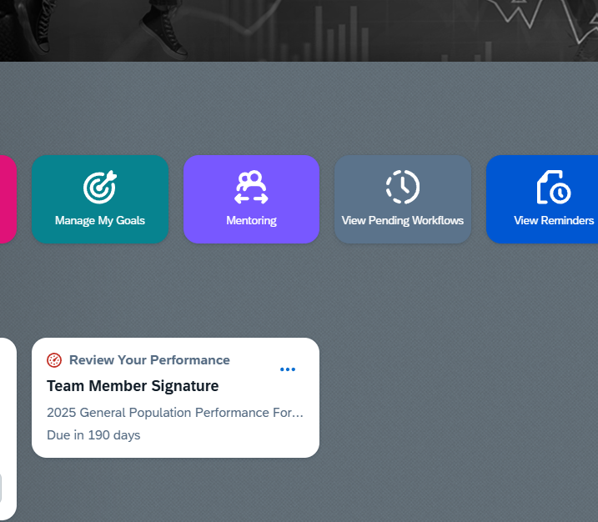
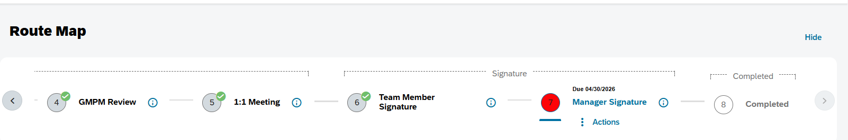
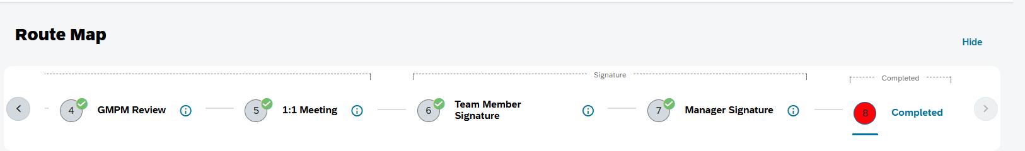
SuccessFactors: 2025 Performance Form Screenshots
Team member adds self- ratings on Leadership Competencies .
Team member forwards the form to the next step.
The Form moves to the Team Member’s manager
Manager finds it on Home page - ‘Manager Assessment’ tile.
Manager provides Leadership Competency Rating for the Team Member
Manager overrides ‘Overall Rating’ manually and sends the form to the next step to calibration.
Manager finds it on Home page as ‘Calibration’ tile.
After Calibration step is completed, the form is forwarded to the next step
GMPM administrator finds the request on Home page as ‘GMPM Review’ tile.
Post Completion of GMPM Review, Manager will find 1:1 meeting step on the Homepage tile – 1:1 Meeting
Manager will forward the form for Team member’s signature once 1:1 meeting step will be completed and confirmed
Team member will sign the form
Manager will sign the form.
Team member , manager and HR Champion will each get a copy of this completed signed form in their Outlook as email and will be stored in SF as well.
Route form will display as Completed

